Slide 1


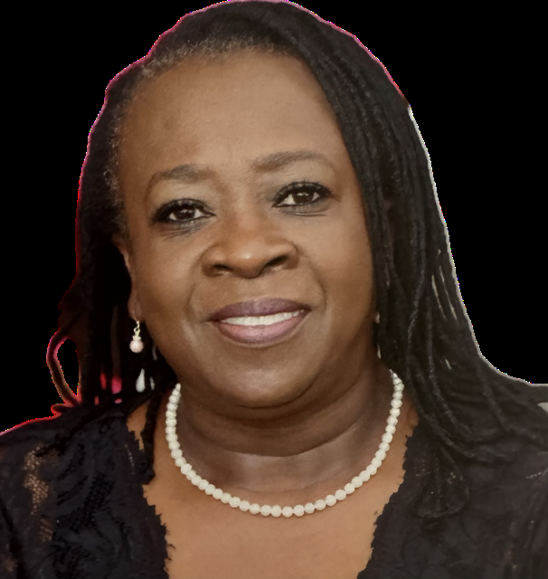




Westside High School
Piedmont Technical College
Associate of Art
General Business
Concordia University
Master of Curriculum and Instruction:
Career and Technical Education
National University
Doctor of Education
Educational Leadership
Dr. Sandra Best
Marketing Teacher
Ask questions, make mistakes, live…LEARN

